Slide 1
Title of presentation to go here
Social Data Institute
Supporting text can be positioned here in multiple lines
Additional details
ucl.ac.uk/social-data

Slide 2
There is a wealth of social data science study taking place across UCL. The Social Data Institute will lead on joined up social data science teaching at UCL, maximising teaching efficiencies and developing a strong pipeline of skilled social data scientists.
Social Data Institute

Slide 3
The future of data and methods
Social Data Institute
Within the social and historical sciences, the future of data and methods demands our attention. Sources of non-traditional, unstructured data are opening up new vistas for research, and new techniques such as text mining, modelling and simulation, data visualisation and the use of AI are extending the scope of computational social science and the digital humanities. Increasingly, graduates are expected to be able to understand not just how to manipulate and analyse large and complex datasets, but also to understand the ethical, social, and political dimensions to the use of these data, in order to advocate for better practice in their use.
The UCL Social Data Institute is a cross-Faculty response to these challenges.
Social Data Science Pathways
The Institute builds on the work of the Q-Step Centre, which is a nationally recognised centre of excellence in the teaching of data science to undergraduates in the social sciences, initially funded by the Nuffield Foundation. This collaborative infrastructure for teaching and employability initiatives will be augmented by the Social Data Institute’s broadened remit. In addition, SHS already produces world-leading research at the cutting edge of data and methods, so the Institute offers the opportunity to amplify this research and to establish a wide-reaching collaborative network of engaged scholars and external partners.

Slide 4
The Social Data Institute is challenge-led, responding to shared institutional priorities and striving to improve opportunities and efficiencies for students and staff working with social data. Our agenda reflects the Faculty’s evolving interests and expertise, and gives flexible to allow us to respond at speed to data-related challenges in the real world.
Social Data Institute
Colleagues affiliated with the institute will benefit from:
A support network for those engaged in data and methods teaching
Leveraging existing UCL investments in data-intensive social science research
Advocacy for social science led computing initiatives through the recently launched Centre for Advanced Research Computing and the Data Safe Haven
Additional teaching support – where possible – to augment data and methods related modules within the Faculty
Support for relevant events and outreach activities
The work of the Institute will be overseen by a steering committee comprising stakeholders from across UCL, and informed by an external advisory board.
In addition to becoming affiliated to the Institute there are a number of leadership roles available:
As a Deputy Director of one of the challenge areas (Teaching, Research Collaboration, Innovation & Partnerships)
As a member of the Steering Committee to help to drive the Institute’s challenge-led agenda

Slide 5
There is a wealth of social data science study taking place across UCL. The Social Data Institute will lead on joined up social data science teaching at UCL, maximising teaching efficiencies and developing a strong pipeline of skilled social data scientists.
Social Data Institute

Slide 6

The future of data and methods
Social Data Institute
Within the social and historical sciences, the future of data and methods demands our attention. Sources of non-traditional, unstructured data are opening up new vistas for research, and new techniques such as text mining, modelling and simulation, data visualisation and the use of AI are extending the scope of computational social science and the digital humanities. Increasingly, graduates are expected to be able to understand not just how to manipulate and analyse large and complex datasets, but also to understand the ethical, social, and political dimensions to the use of these data, in order to advocate for better practice in their use.
The UCL Social Data Institute is a cross-Faculty response to these challenges.

Slide 7


There is a wealth of social data science study taking place across UCL. The Social Data Institute will lead on joined up social data science teaching at UCL, maximising teaching efficiencies and developing a strong pipeline of skilled social data scientists.
Social Data Institute

Slide 8



The future of data and methods
Social Data Institute
Within the social and historical sciences, the future of data and methods demands our attention. Sources of non-traditional, unstructured data are opening up new vistas for research, and new techniques such as text mining, modelling and simulation, data visualisation and the use of AI are extending the scope of computational social science and the digital humanities. Increasingly, graduates are expected to be able to understand not just how to manipulate and analyse large and complex datasets, but also to understand the ethical, social, and political dimensions to the use of these data, in order to advocate for better practice in their use.
The UCL Social Data Institute is a cross-Faculty response to these challenges.

Slide 9
There is a wealth of social data science study taking place across UCL. The Social Data Institute will lead on joined up social data science teaching at UCL, maximising teaching efficiencies and developing a strong pipeline of skilled social data scientists.
Social Data Institute

Slide 10

The future of data and methods
Social Data Institute
Within the social and historical sciences, the future of data and methods demands our attention. Sources of non-traditional, unstructured data are opening up new vistas for research, and new techniques such as text mining, modelling and simulation, data visualisation and the use of AI are extending the scope of computational social science and the digital humanities. Increasingly, graduates are expected to be able to understand not just how to manipulate and analyse large and complex datasets, but also to understand the ethical, social, and political dimensions to the use of these data, in order to advocate for better practice in their use.
The UCL Social Data Institute is a cross-Faculty response to these challenges.
Social Data Science Pathways
The Institute builds on the work of the Q-Step Centre, which is a nationally recognised centre of excellence in the teaching of data science to undergraduates in the social sciences, initially funded by the Nuffield Foundation. This collaborative infrastructure for teaching and employability initiatives will be augmented by the Social Data Institute’s broadened remit. In addition, SHS already produces world-leading research at the cutting edge of data and methods, so the Institute offers the opportunity to amplify this research and to establish a wide-reaching collaborative network of engaged scholars and external partners.

Slide 11
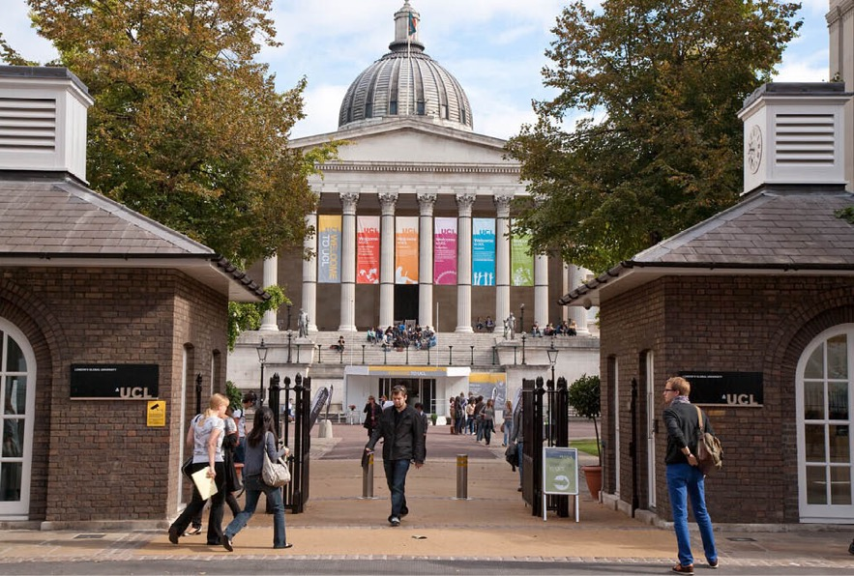
There is a wealth of social data science study taking place across UCL. The Social Data Institute will lead on joined up social data science teaching at UCL, maximising teaching efficiencies and developing a strong pipeline of skilled social data scientists.
Social Data Institute

Slide 12
UCL Q-Step
Social Data Institute
The UCL Q-Step Centre provides social science students with state of the art training in social data science, through courses in quantitative research methods, data analysis and visualization.
Study
UCL is a multi-disciplinary university, internationally recognized for our exceptional inter-disciplinary teaching and research collaborations. The UCL Q-Step Centre offers training in data science on four innovative and inter-disciplinary undergraduate degree programmes. Read more »
The data science training that Q-Step students receive is in high demand. Employers from public, private and the third-sector desperately need people who can draw out insights from quantitative data to inform policymaking, organizational strategy and resources. Read more »

Slide 13
Q-Step modules
Social Data Institute
First Year Q-Step Modules
UCL is a multi-disciplinary university, internationally recognized for our exceptional inter-disciplinary teaching and research collaborations. The UCL Q-Step Centre offers training in data science on four innovative and inter-disciplinary undergraduate degree programmes. Read more »
Second Year Q-Step Modules
UCL is a multi-disciplinary university, internationally recognized for our exceptional inter-disciplinary teaching and research collaborations. The UCL Q-Step Centre offers training in data science on four innovative and inter-disciplinary undergraduate degree programmes. Read more »
Third Year Q-Step Modules
UCL is a multi-disciplinary university, internationally recognized for our exceptional inter-disciplinary teaching and research collaborations. The UCL Q-Step Centre offers training in data science on four innovative and inter-disciplinary undergraduate degree programmes. Read more »

